Slide 1
SIDES ONLINE REGISTRATION PROCESS
SIDES Registration Instructions
Mirjam Nilsson
12/08/2022

Slide 2
Online registration in the
State Information Data Exchange System (SIDES)
is easy through the WorkForce West Virginia website at:
https://workforcewv.org/unemployment/employers/online-employer-services

Slide 3
Step-by-Step Instructions
SIDES registration is completed on the same website used to file contribution/wage reports. Establishing a WV.gov account is necessary for both the Online Employer Filing and SIDES registration.
Screen shots of each step listed below are provided.
Click File Online Here
Click the I Agree button on the Privacy Notice Summary and Notice to Users screens
If there is an established WorkForce Online Unemployment Compensation Employer Contribution Account, log in on this screen and proceed to the SIDES Sign-Up icon.
If there is not an established account, create a WV.gov account by clicking on the Create an Account here link then the link to Accounts Page on the next screen.
Click the Sign-Up button on the WV.gov Accounts page. Complete the registration forms and verify receipt of the email that will be sent. IT IS ESSENTIAL THAT THE EMAIL IS VERIFIED TO BECOME FULLY REGISTERED WITH THE WV.GOV ACCOUNT.
Return to https://workforcewv.org/unemployment/employers/online-employer-services to log into the Online Unemployment Compensation Employer Contribution System with the log in credentials created in the WV.gov system
Click on the Sign-Up icon to enroll into E-SIDES
The next few screens will provide detailed information and disclaimers/acknowledgements of the employer’s agreement regarding this electronic service. Contact information, including the email address where all requests for separation information and earnings verification will be directed, is to be entered on this form.
An email will be sent to the email address registered. Once verified, the E-SIDES account is active. IT IS ESSENTIAL THAT THE EMAIL SENT TO THE REGISTERED EMAIL ADDRESS IS VERIFIED OR THE REGISTRATION WILL NOT BE VALID.

Slide 4
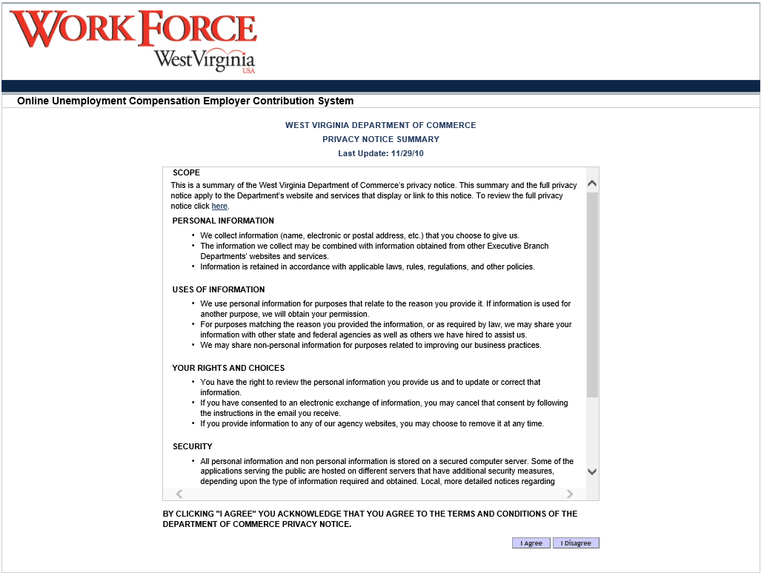
WV Department of Commerce Privacy Notice Summary Screen

Slide 5
Notice to Users

Slide 6
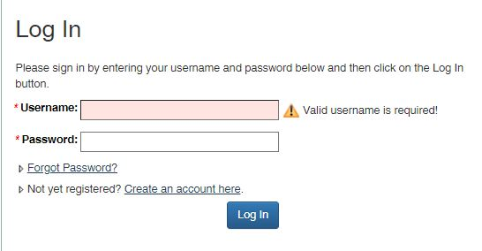
Create a WV.gov Account
To create a WV.gov account, please click on the Create an account here link and it will redirect to the sign-up page for a WV.gov account. If there is an account already established, please log-in.

Slide 7
Create a WV.gov Account

Slide 8
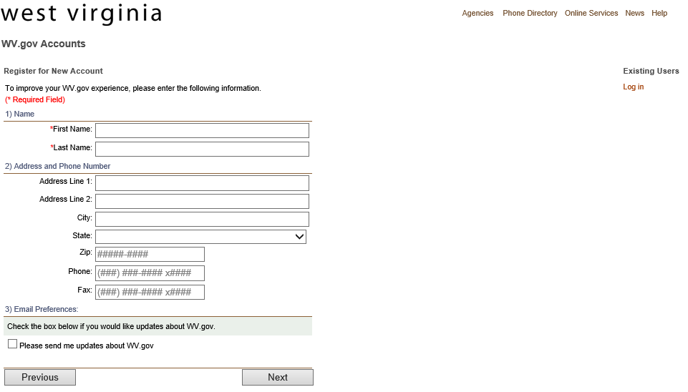
Register for a new account

Slide 9
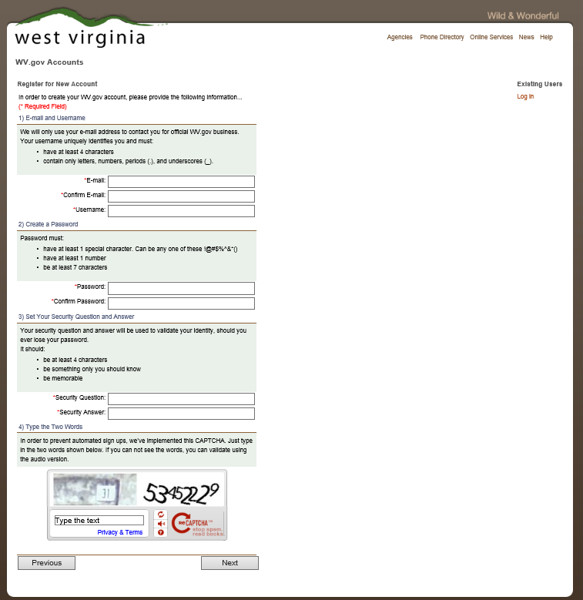
Register for a new account

Slide 10
At this point, users will receive a verification email. Upon receipt of this email, please click this link to complete the account creation.

Slide 11
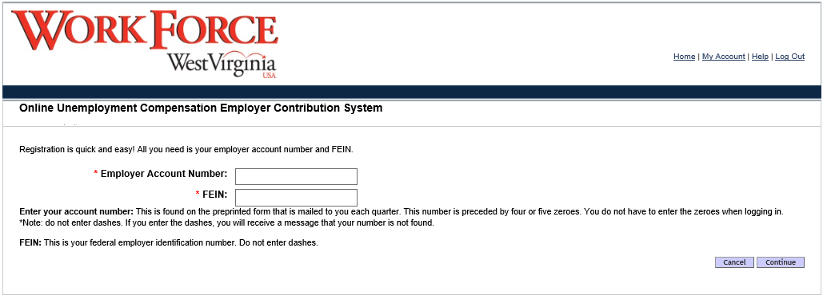
Online Services Registration Forms
If an error message appears stating a different person is the administrator of the account, please send and email to EUCC@WVInteractive.com for assistance.

Slide 12
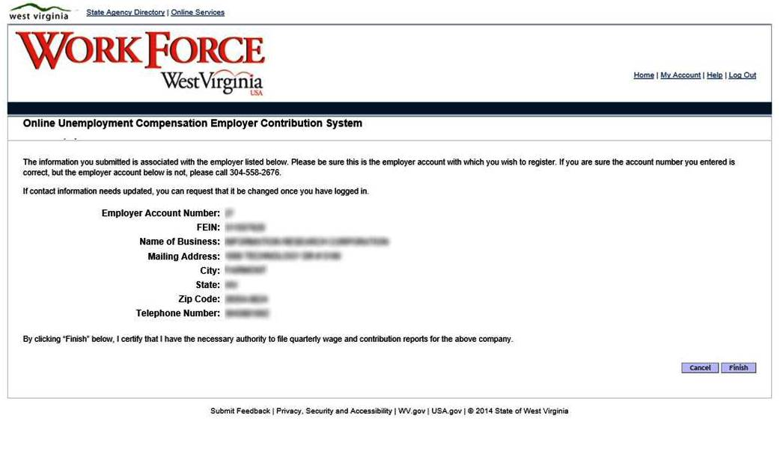
Registered

Slide 13
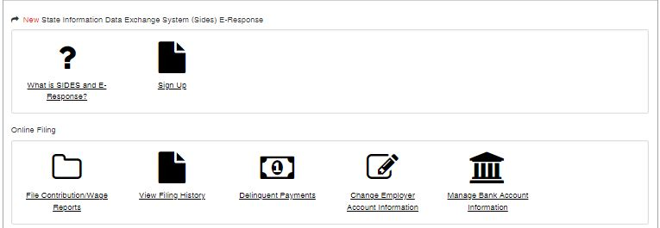
Listing of Online Services for Employers
Once enrolled the name of this icon will change. This is the location to update contact information if the need would arise.

Slide 14
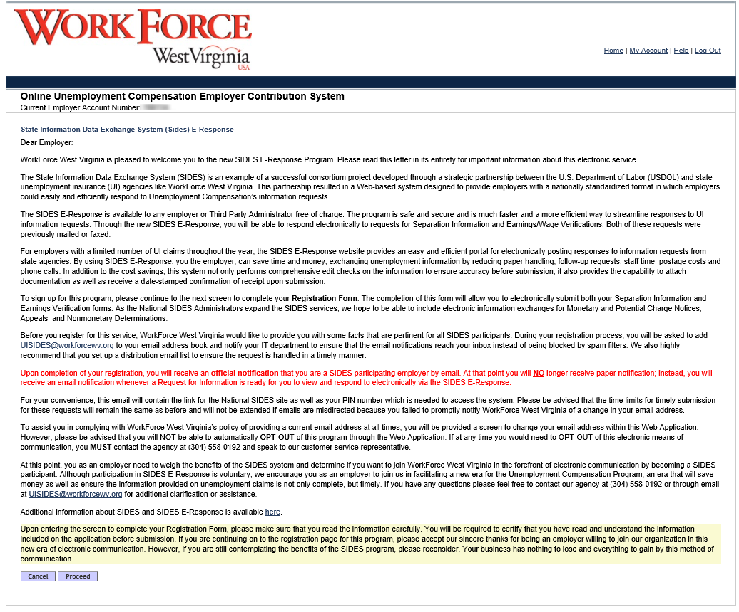

Slide 15
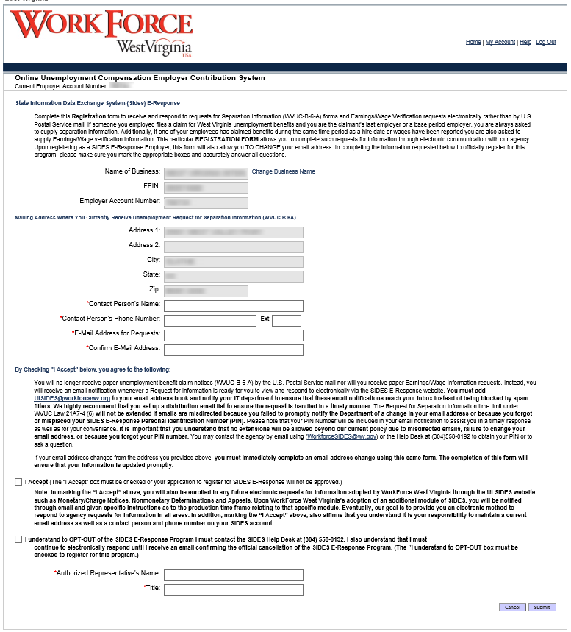

Slide 16
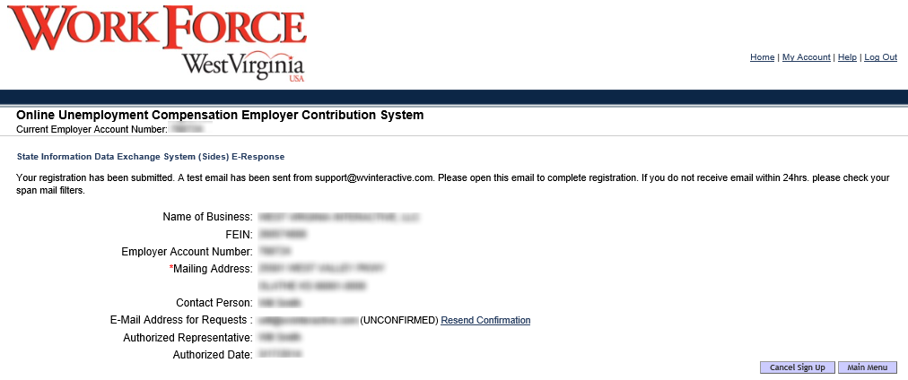
SIDES E-Response Information
Only one email address can be registered per business. It is recommended a shared email address is used to ensure requests are handled in a timely manner.

Slide 17
SIDES Help Desk
If you have any questions or just want more information about SIDES, please call (304) 352-0946 or email us at: WorkForceSIDES@wv.gov
To opt-out of SIDES, you must contact the Help Desk above

